Slide 1
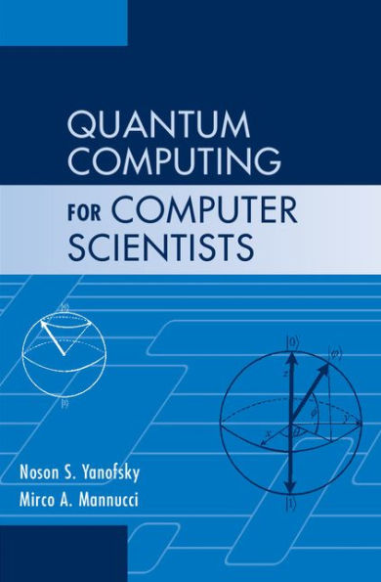
Architecture
Slides prepared by Dr. Leon Deligiannidis
These slides are based from the book:
Noson S. Yanofsky, Mirco A. Mannucci, “Quantum Computing for Computer Scientists”. Cambridge University Press ISBN 987-0-521-87996-5

Slide 2
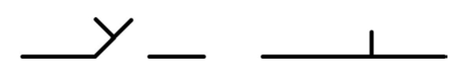
Bits and Qubits
What is a bit?
A bit is a unit of information describing a two-dimensional classical system.
There are many examples of bits:
A bit is electricity traveling through a circuit or not (or high and low). A bit is a way of denoting “true” or “false.” A bit is a switch turned on or off.
All these examples are saying the same thing: a bit is a way of describing a system whose set of states is of size 2. We usually write these two possible states as 0 and 1, or F and T, etc.

Slide 3
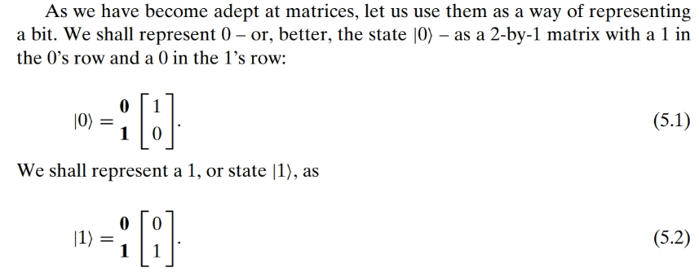

Slide 4
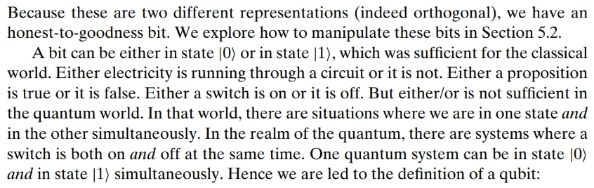

Slide 5
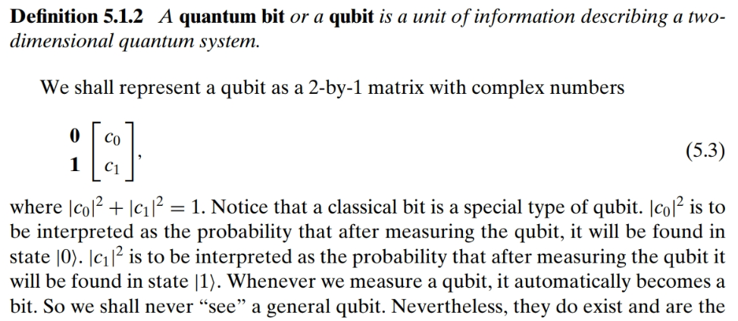

Slide 6
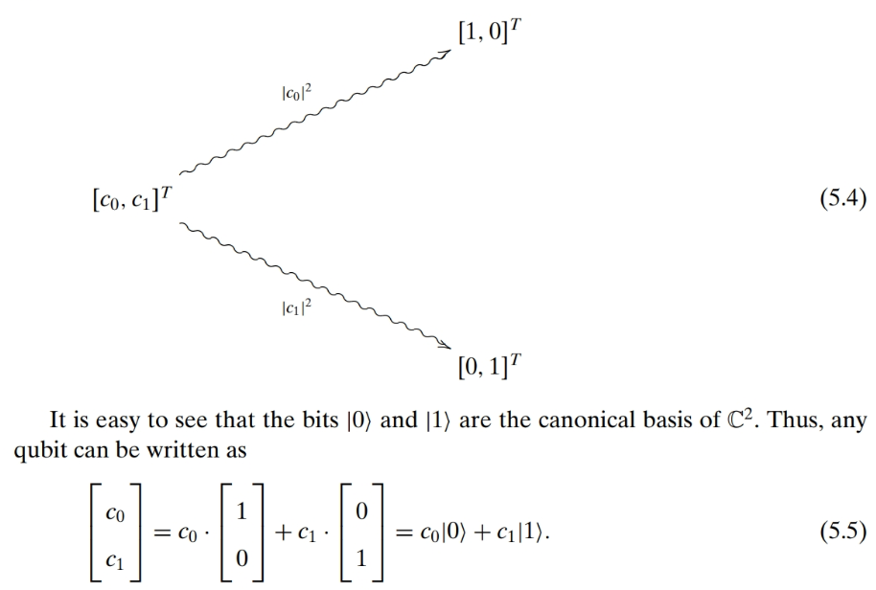

Slide 7
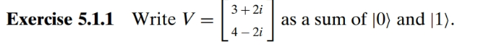
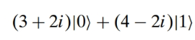

Slide 8
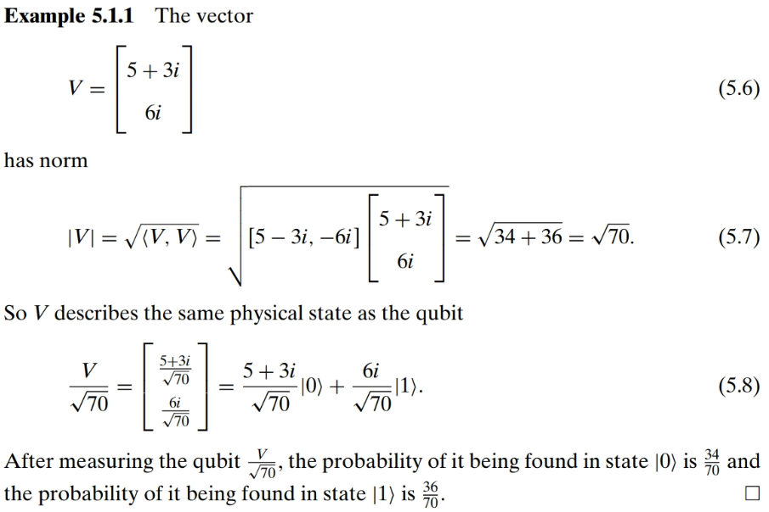
(5-3i)(5+3i) = 25 +15i-15i-9i²=25+9=34

Slide 9
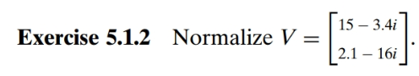
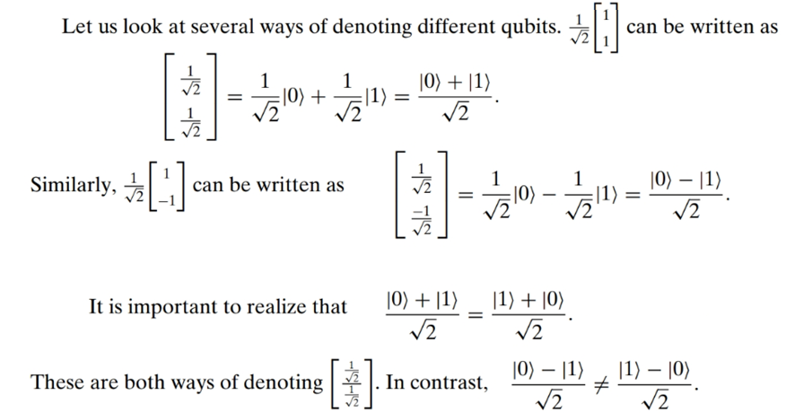
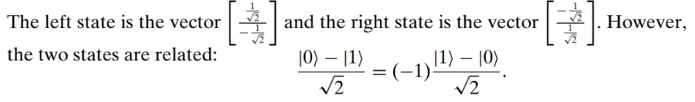

Slide 10
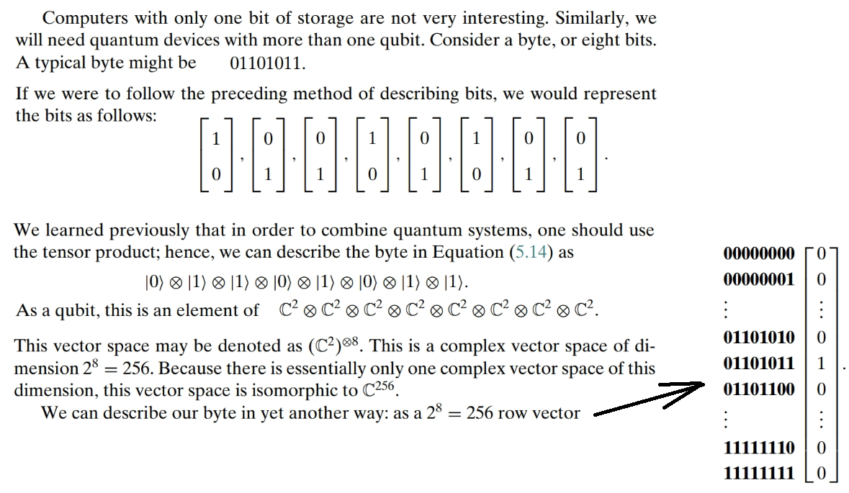

Slide 11
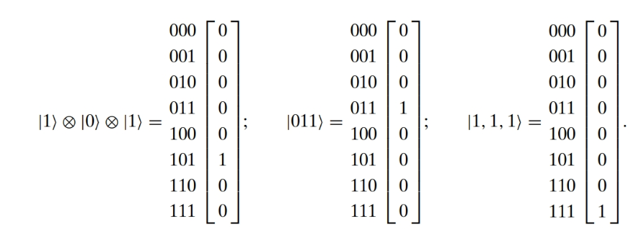

Slide 12
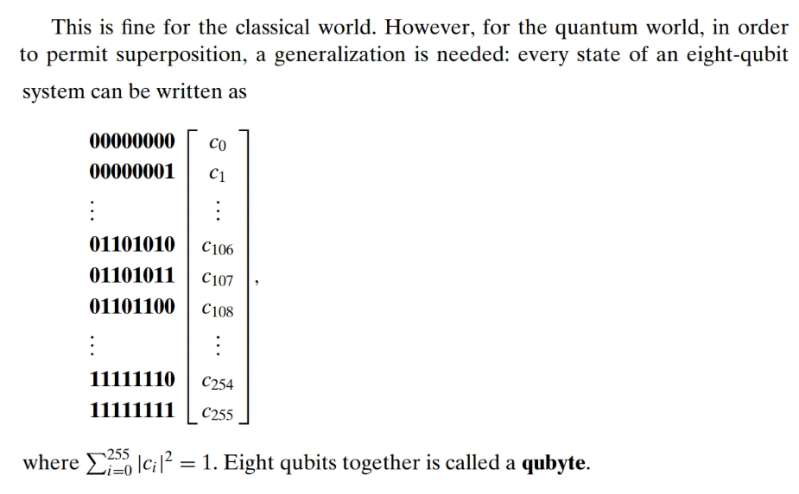
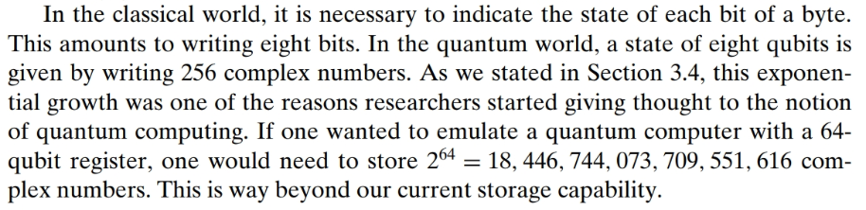

Slide 13
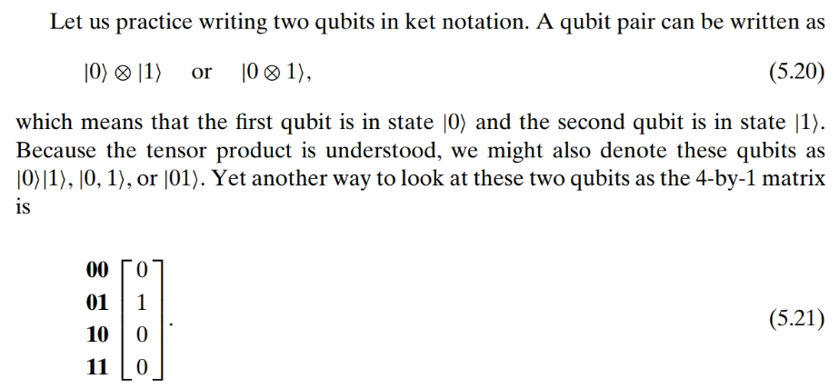

Slide 14
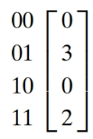
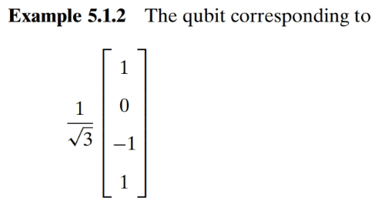
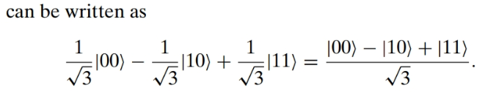

Slide 15
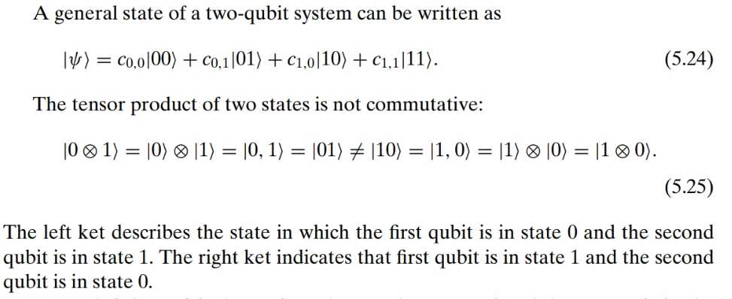

Slide 16
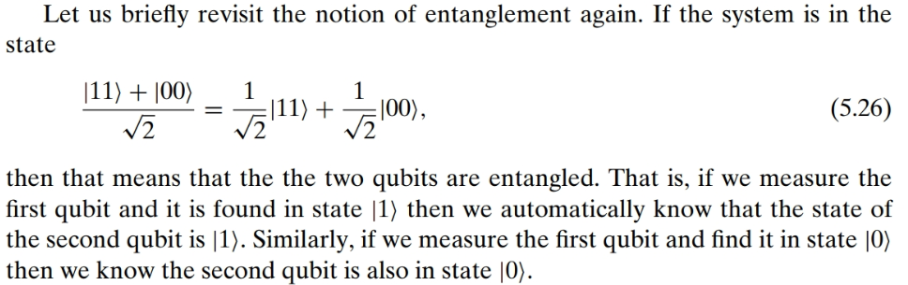

Slide 17
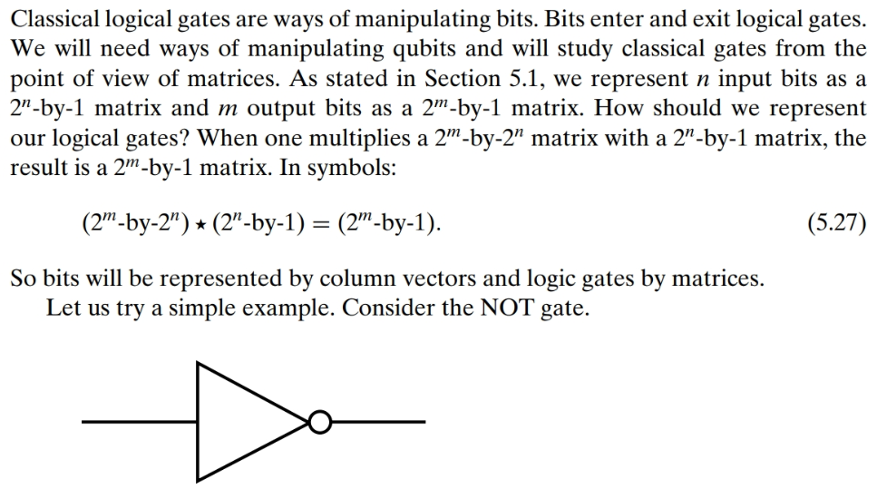
Classical Gates

Slide 18
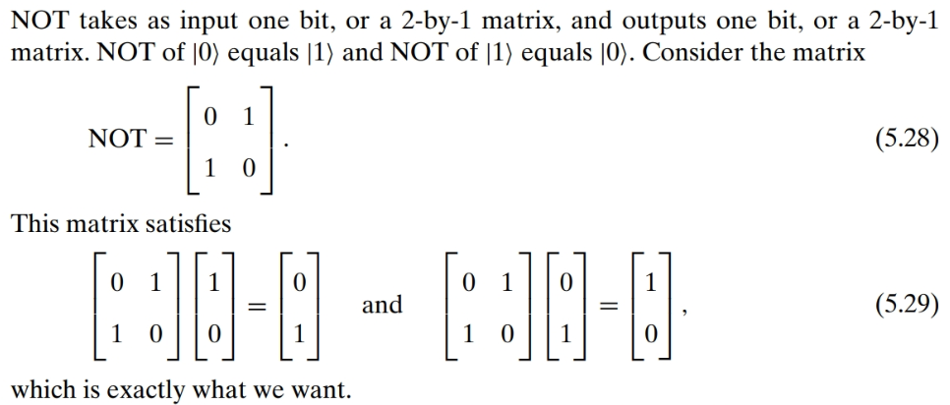

Slide 19
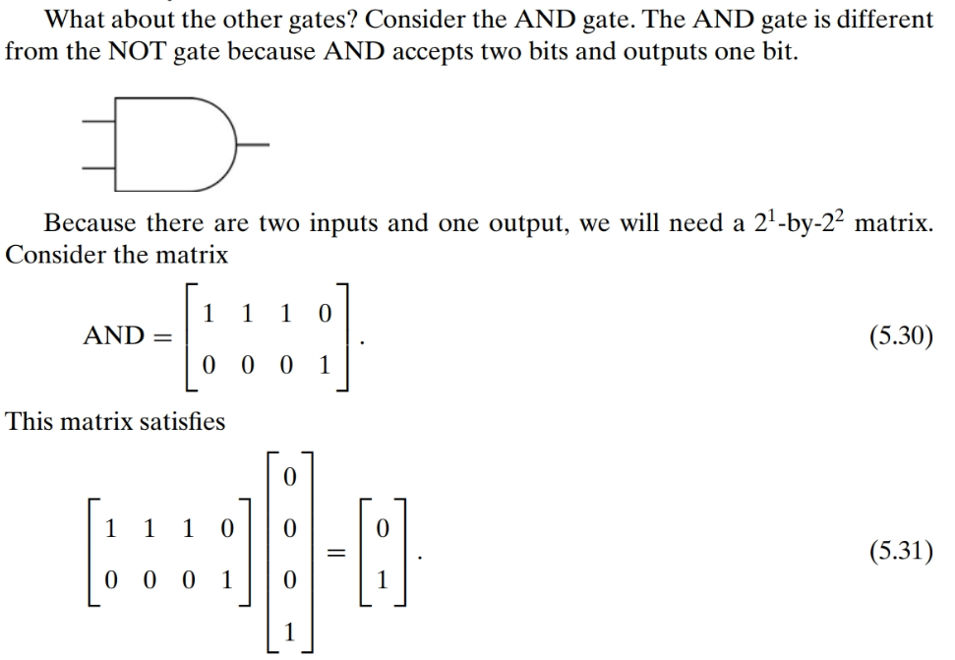
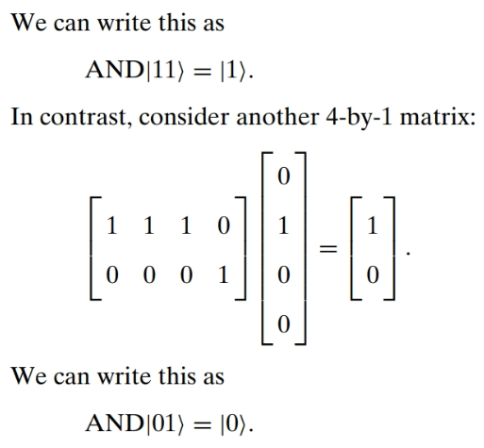

Slide 20
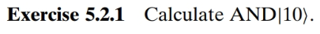
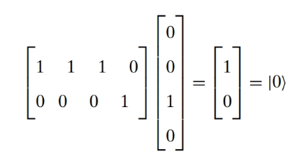
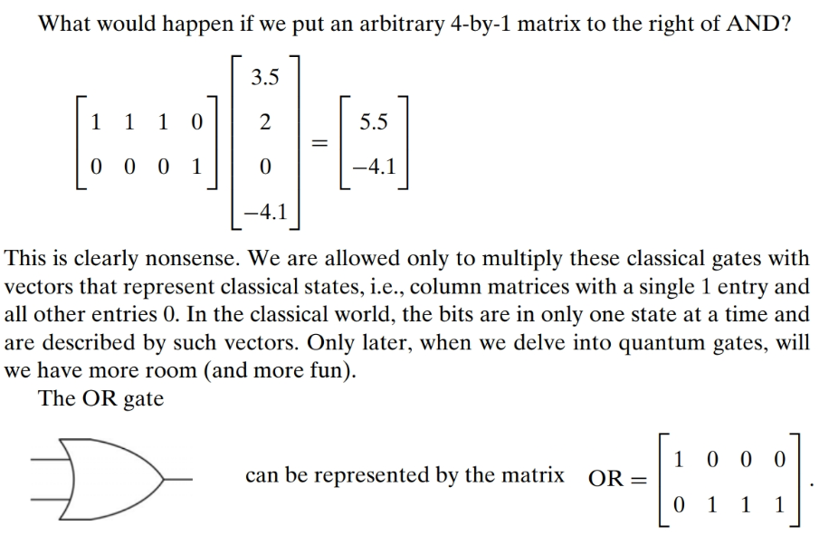

Slide 21
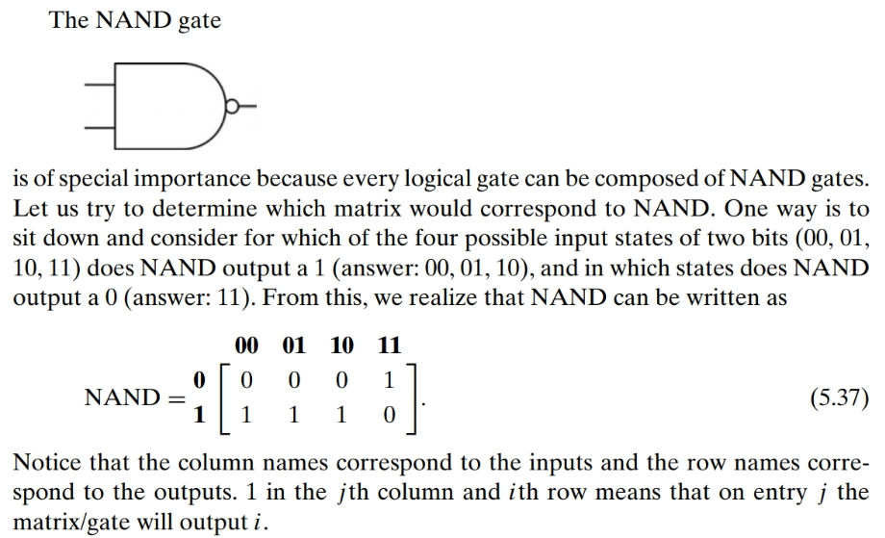

Slide 22
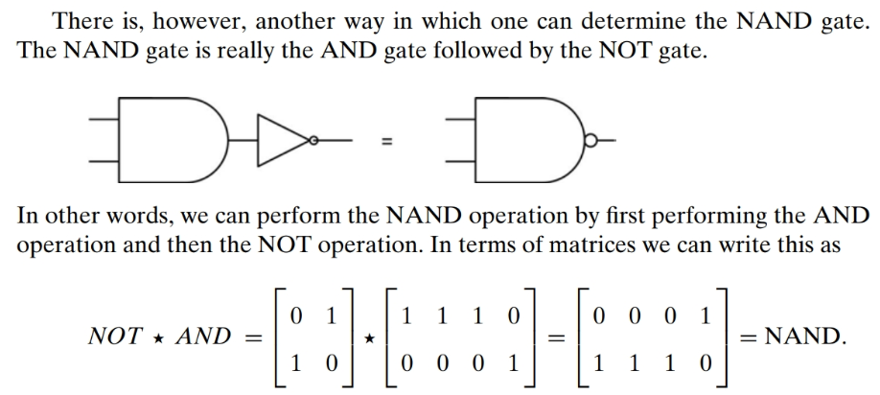

Slide 23
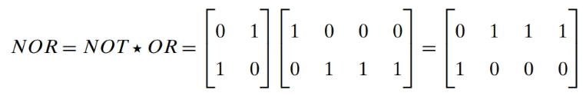

Slide 24
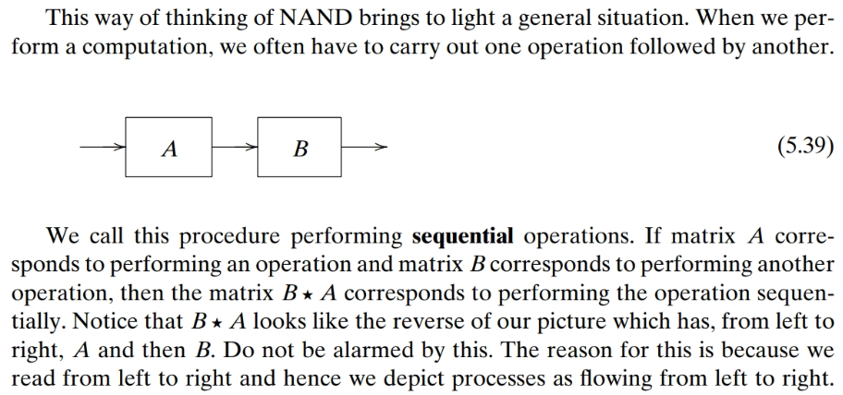

Slide 25
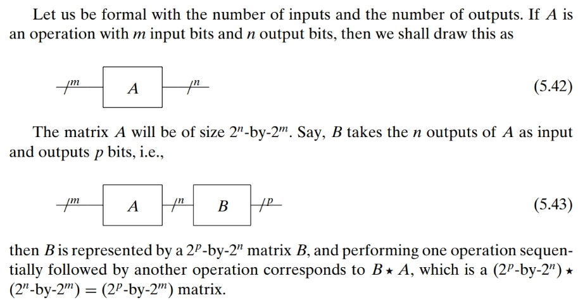

Slide 26
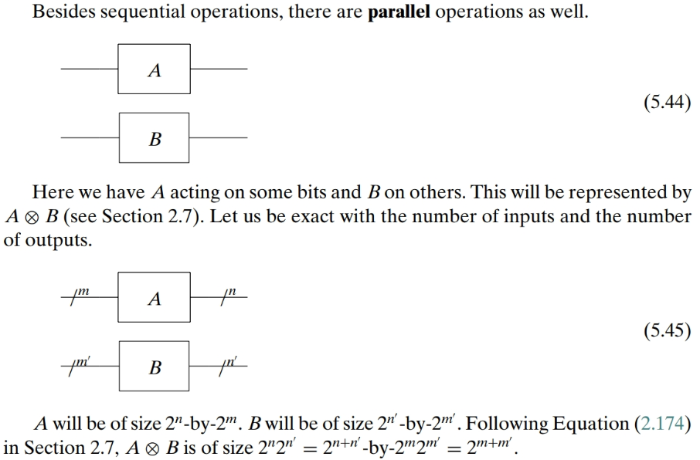

Slide 27
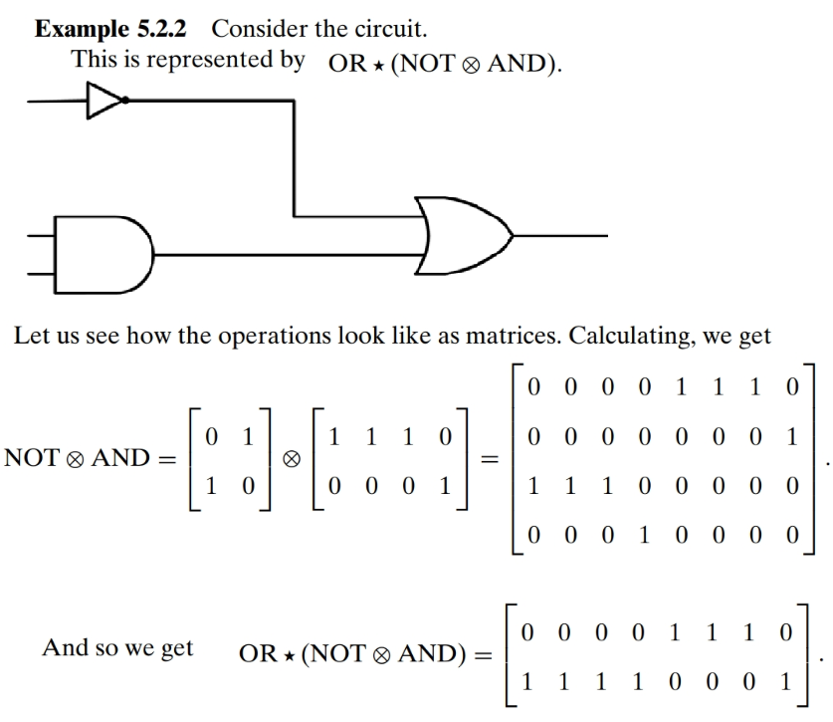

Slide 28
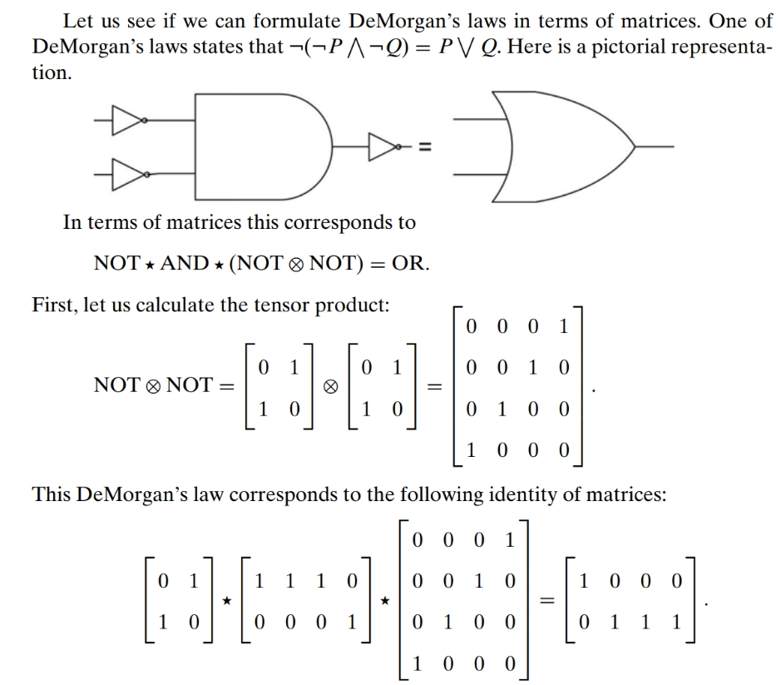

Slide 29
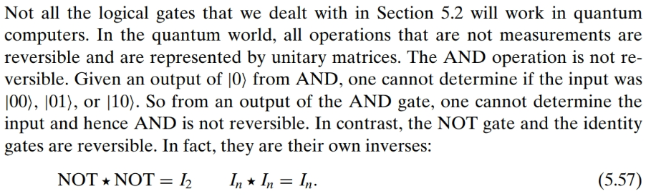
Reversible Gates

Slide 30
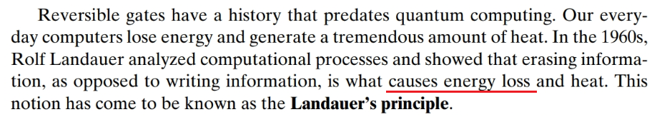

Slide 31
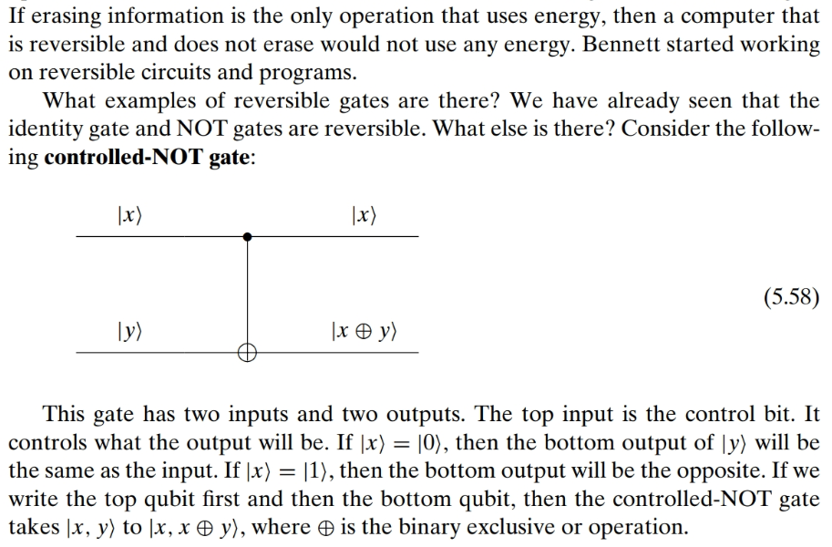

Slide 32
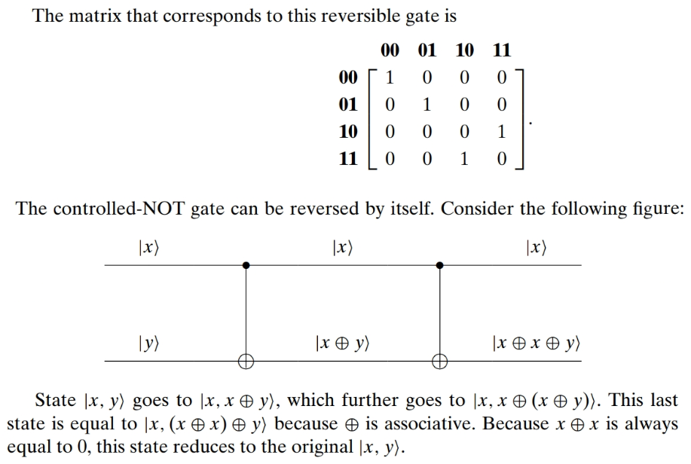

Slide 33
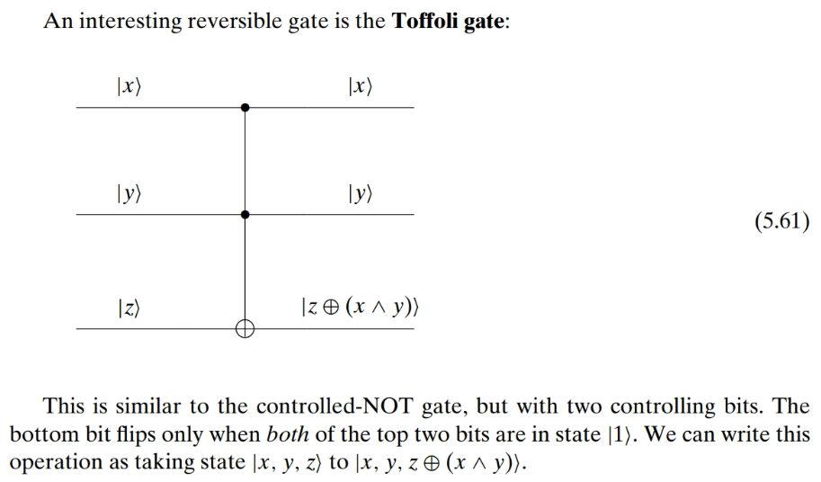
Toffoli Gate

Slide 34
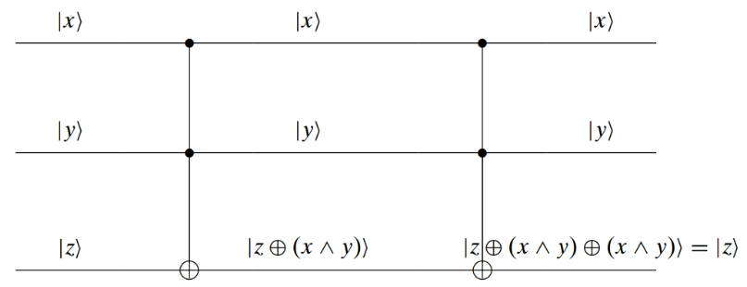

Slide 35
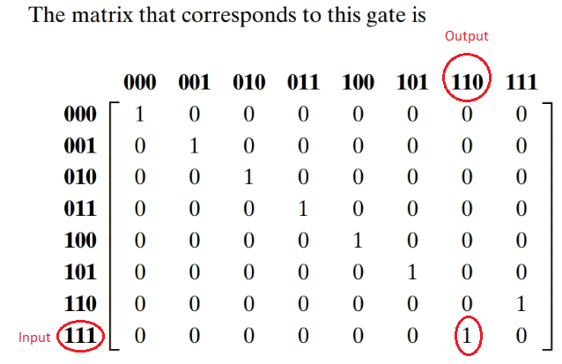

Slide 36
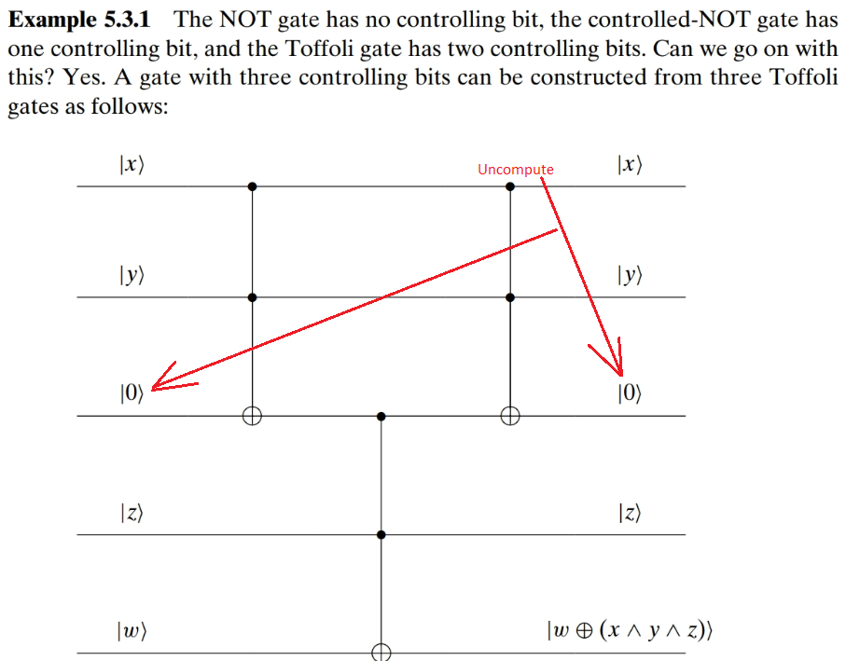

Slide 37
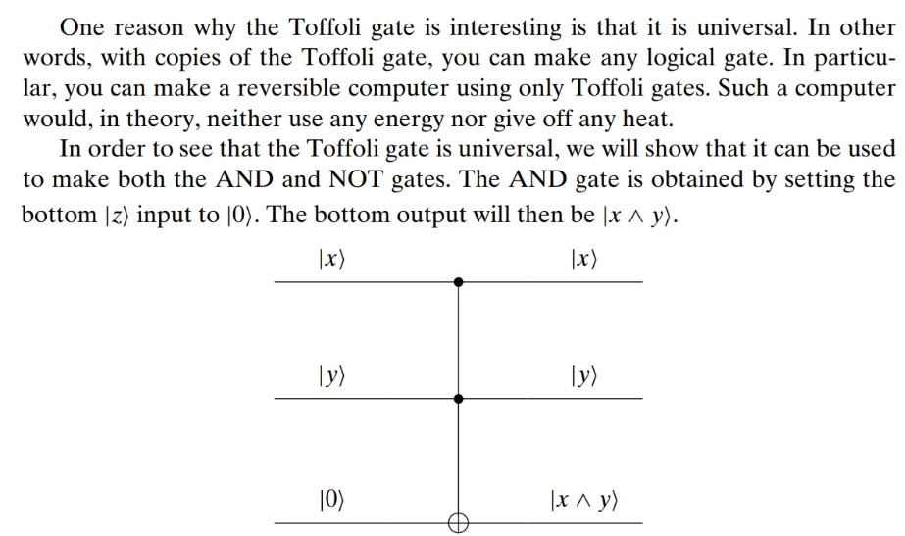

Slide 38
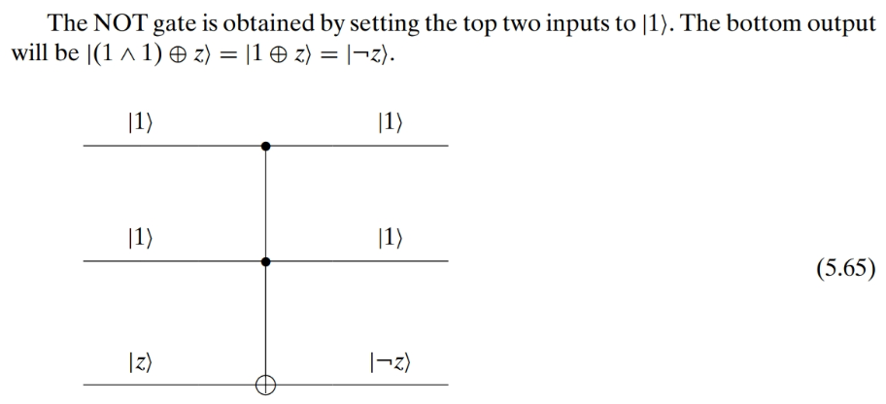

Slide 39
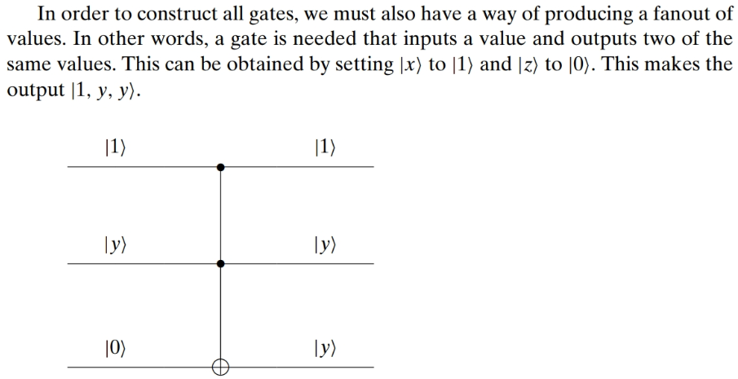
COPY ??
This makes entangled copies, not independent copies!
Look @ phase kickback
Look @ teleportation
This does not violate the “no-cloning” theorem.

Slide 40
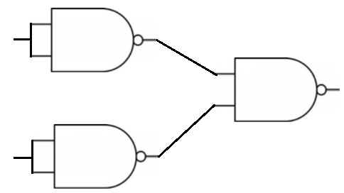
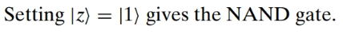

Slide 41


Slide 42


Slide 43


Slide 44


Slide 45

Quantum Gates

Slide 46


Slide 47


Slide 48


Slide 49


Slide 50


Slide 51



Slide 52


Slide 53




Source: https://warwick.ac.uk/fac/sci/physics/research/cfsa/people/pastmembers/charemzam/pastprojects/mcharemza_quant_circ.pdf
and
or
swap
fanout

